Slide 1


Open Elective - Transportation Systems
Unit IV
Prof. Yogesh S. Lanjewar
Assistant Professor
St. VINCENT PALLOTTI COLLEGE OF ENGINEERING &
TECHNOLOGY,NAGPUR
DEPARTMENT OF CIVIL ENGINEERING

Slide 2
Contents
Docks
Harbour
Port

Slide 3
Importance Water Transport
Water transport is the cheapest and the oldest mode of transport.
It has the largest carrying capacity and is most suitable for carrying bulky goods over long distances.
The cost of operation of water transport is also very less.
It operates on a natural track and hence does not require huge capital investment in the construction and maintenance.

Slide 4
Terminologies
There are various terminologies used in the marine industry.
Ordinary people are unaware of specific terms that are confused with one another.
Here`s the difference between a dock, harbour, and port.

Slide 5
Introduction to Dock
A dock is a human-made structure or landing area near the shore where boats or ships are loaded, unloaded, and repaired.
The ships and boats are designated with a docking space to load and unload before mooring.
It is usually a place to connect passengers to the land.

Slide 6
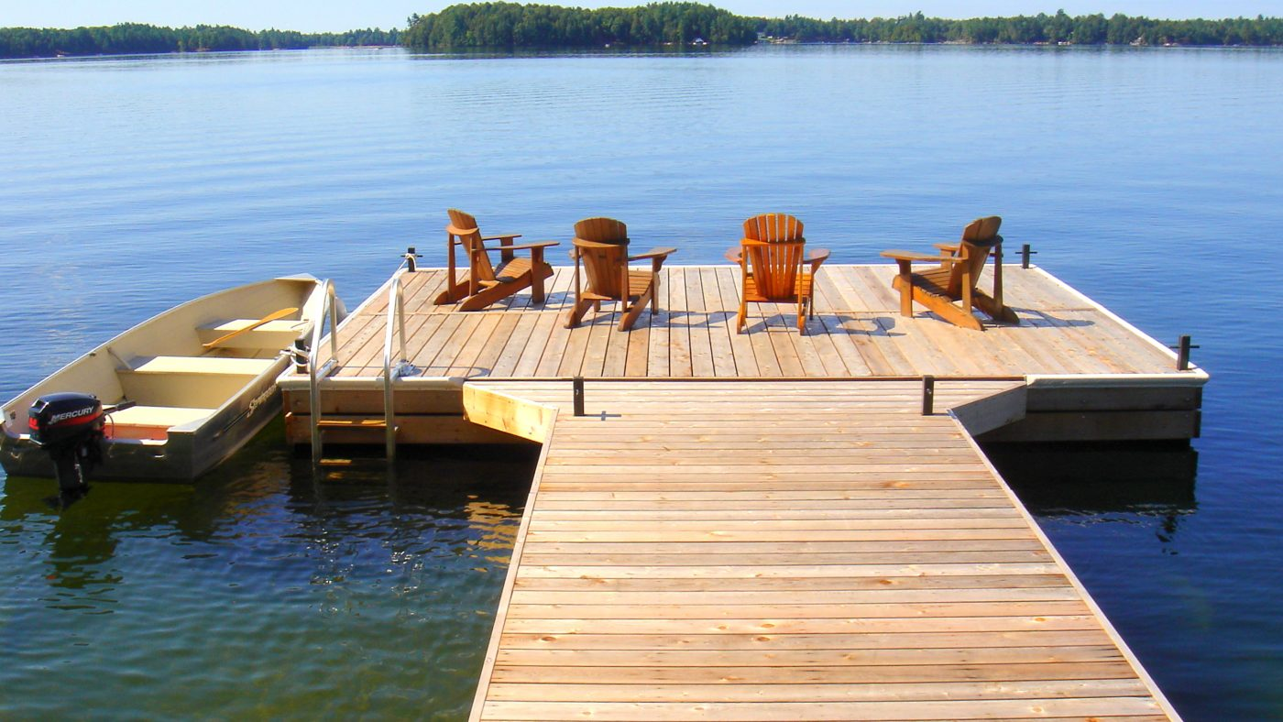

Slide 7
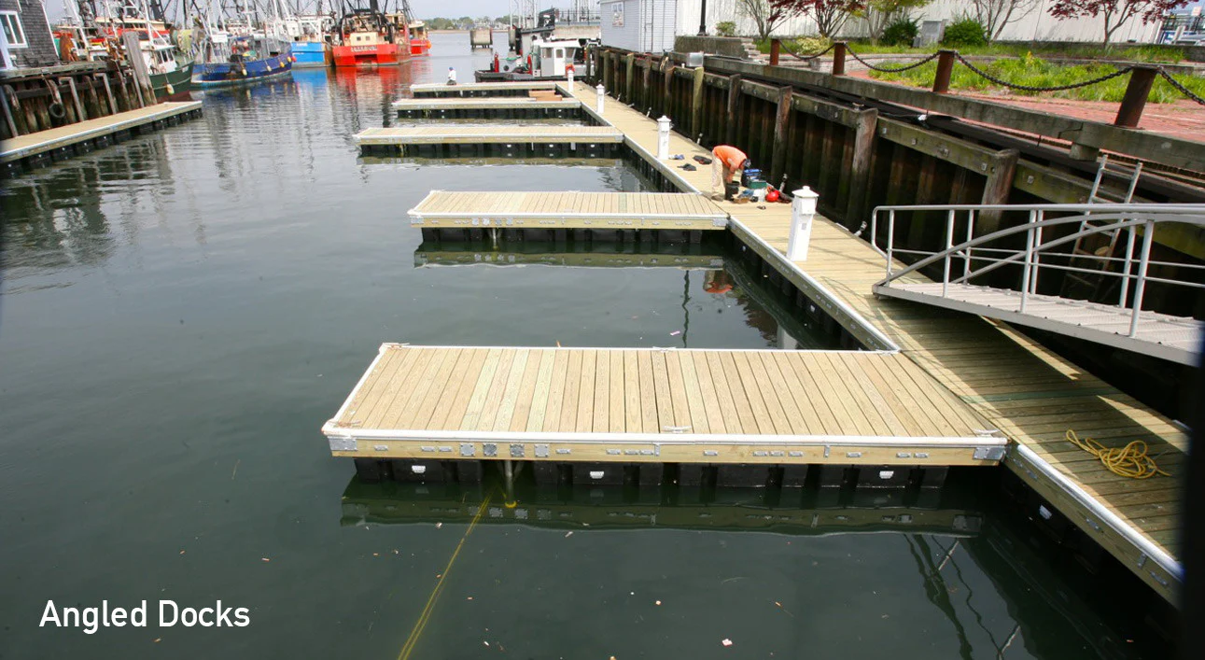

Slide 8
Introduction to Dock……
Docks are enclosed areas for berthing the ships to keep them afloat at a uniform level to facilitate loading and unloading cargo.
A dock is a marine structure for berthing of vessels for loading and unloading cargo and passengers.
Classification of Docks:
Wet Dock
Dry Dock

Slide 9
Dry Dock
The docks used for repairs of ships are known as dry docks.
It is long excavated chamber, having side walls, a semi circular end wall and a floor.
The open end of the chamber is provided with a gate and acts as the entrance to the dock.

Slide 10
Wet Dock
Docks required for berthing of ships or vessels to facilitate the loading and unloading of passengers and cargo are called wet docks.
These are also known as harbor docks.

Slide 11
Introduction to Harbour
Harbour is a place on the coast where boats and ships moor to allow the transfer of goods and passengers.
A harbour is generally a sheltered waterbody that can be natural or partially human-made.
There must be a harbour that exists before setting up a port facility.
Several harbours sometimes serve some particular ports.

Slide 12
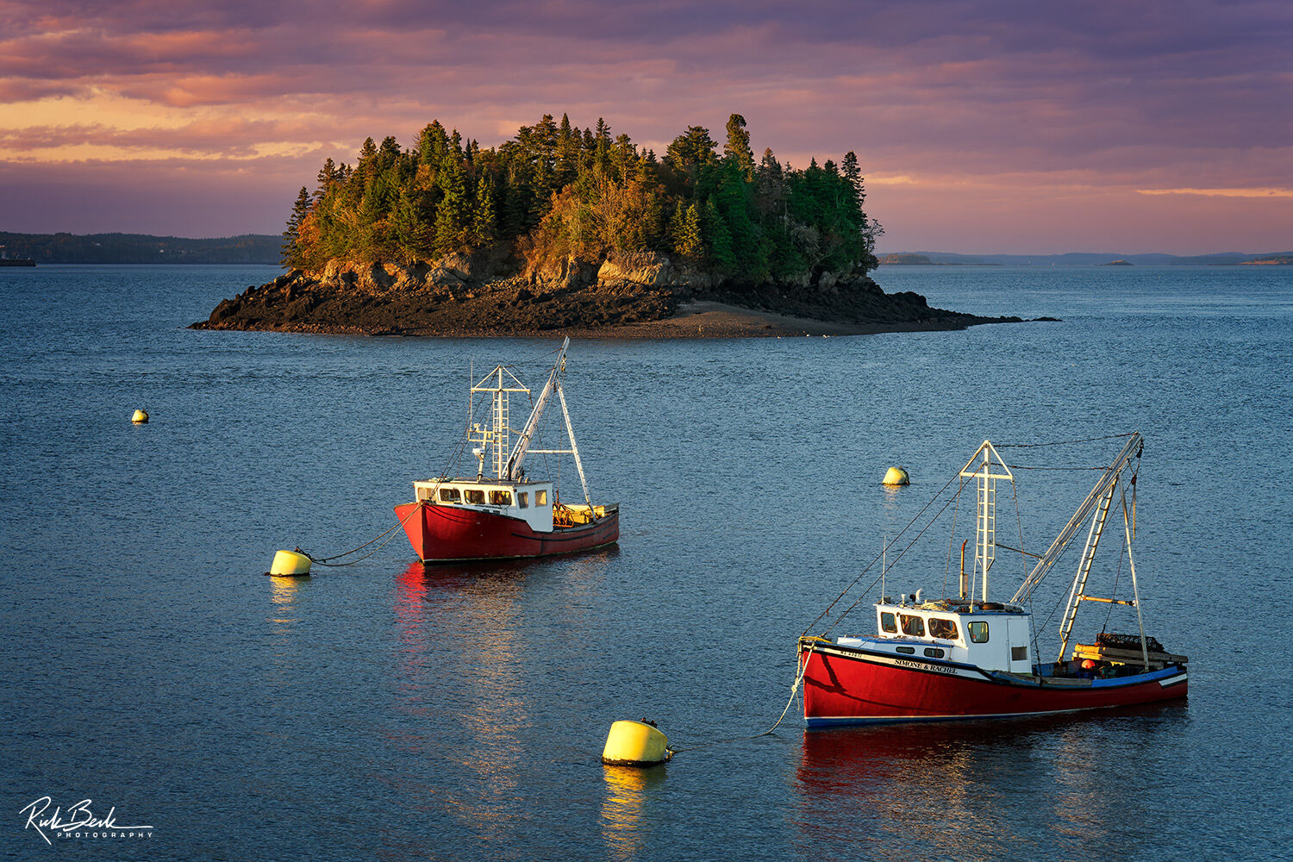

Slide 13
Harbours have direct access to open water, and they are deep enough for safe entry and exit of ships.
They will also be defensive against huge waves and storms.
Harbours are categorized based on their location and structure.
There are coastal harbours, coastal breakwater harbours, tide gate harbours, natural river harbours, lake or canal harbours, etc., that operate for different services.

Slide 14
Parts of Harbour
Entrance Channels
Berthing Basin
Break Water
Turning Basin
Pier Head
Wharves
Jetties

Slide 15
Classification of Harbour
Natural Harbour
Semi Natural Harbour
Artificial Harbour

Slide 16
Natural Harbour
It is protected form storms and waves by Prominence of land.
Consist of part of body of water which is protected.
Deep enough for anchorage.

Slide 17
Semi Natural Harbour
The ones who are protected on sides by land and.
Require man- made protection only at entrance.
Artificial Harbour
Man-made harbour.
Deliberately constructed break waters, sea walls ,Jetties, and also dredging is done there.
Requires maintenance by periodic dredging.

Slide 18
Port
A port is generally a docking place where ships land on the coast of the sea or ocean.
Ports are usually located near the sea coast or estuary.
However, some ports can also be attainable near rivers or canals. Ships dock at the ports to load and offload their passengers and cargo.
The majority of the goods and material transports are carried out commonly via ports.

Slide 19
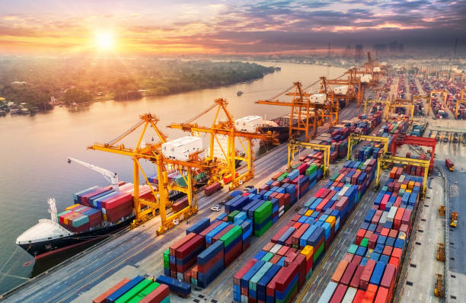
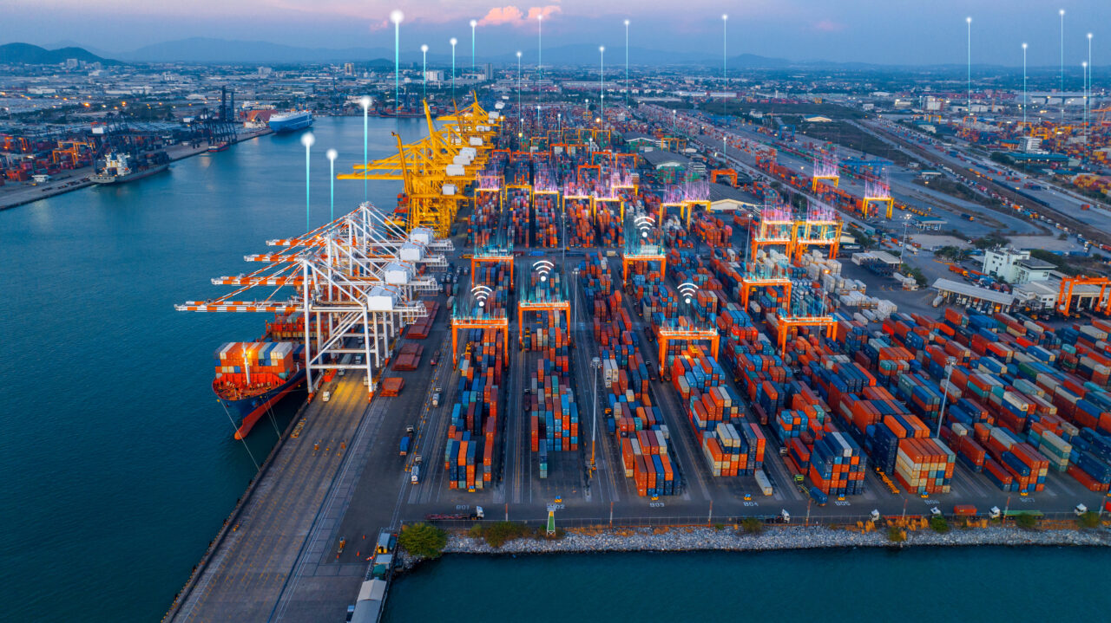

Slide 20
Ships usually have docks in ports to discharge goods and passengers.
In addition, several small harbours serve some ports.
Ports are one of the significant elements of the global economy as most of the worldwide merchandise and trade carry out through ports.
It serves as one of the hubs to allow multinational trade and exchange.

Slide 21
From a layman's perspective, ports are places that facilitate the loading and unloading of passengers and cargo goods.
From a business point of view, a port is a convergence point for cargo domains and businesses.
Ports not only serve for the commercial welfare or trades.
Some ports facilitate exchanges solely, while some ports provide a platform for travellers to enter and leave the cruises, and some ports maybe for another objective.

Slide 22
The facilities available in a port rely on the services they handle.
It is a significant point for the naval and armed forces to set warships before moving into the battle spaces.
The port authority is generally under the government directly or a semi-governmental public administration.

Slide 23



